Slide 1
Graph Theory
Topics to be covered:
Use graphs to model and solve problems such as shortest paths, vertex coloring, critical paths, routing, and scheduling problems
Convert from a graph to an adjacency matrix and vice versa.
Use directed graphs, spanning tress, rooted trees, binary trees, or decision trees to solve problems.
Demonstrate understanding of algorithms such as depth-first and breadth-first walk of a tree or maximal matching.
Use matching or bin-packing techniques to solve optimization and other problems.
Compare and contrast different graph algorithms in terms of efficiency and types of problems that can be solved.

Slide 2
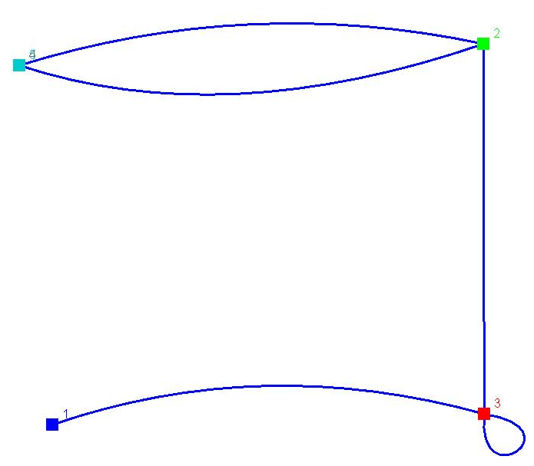
Basic Terminology
A graph consists of a finite set of vertices and edges.
Vertex
Parallel edges
Loop

Slide 3
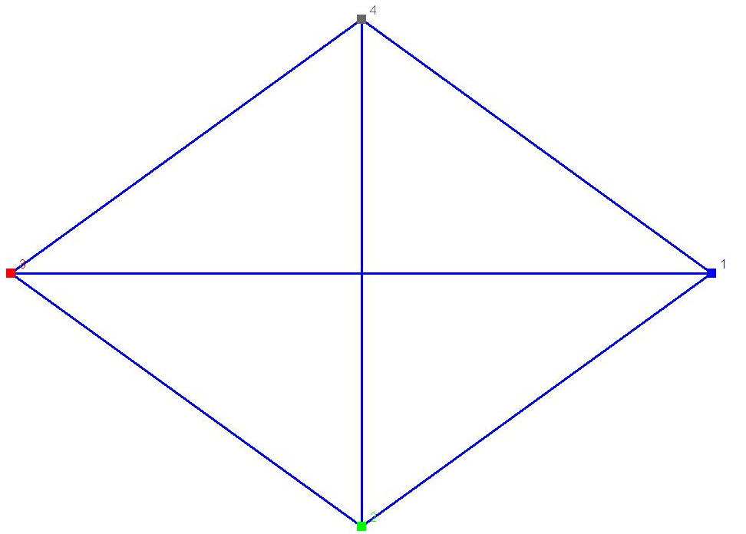
Degrees of Vertices
The degree of a vertex is determined by the number of edges it is connected to.
If all the vertices of a graph have the same degree, then it is a regular graph.
The handshake theorem says that the sum of the degree of all the vertices in graph G is equal to twice the number of edges in G
A corollary of this theorem is that the total degree of a graph is even.
This is an example of a
regular graph. It is also a
complete graph, because
every vertex is connected to
every other vertex.

Slide 4
Adjacency Matrixes
Every graph can be represented by an nxn matrix, where n is the number of vertices in the graph.
For the matrix A = (a_{i,j}) if a_{i,j} = 1 then there is an edge from vertex i to vertex j. If 0 then there is no edge.

Slide 5
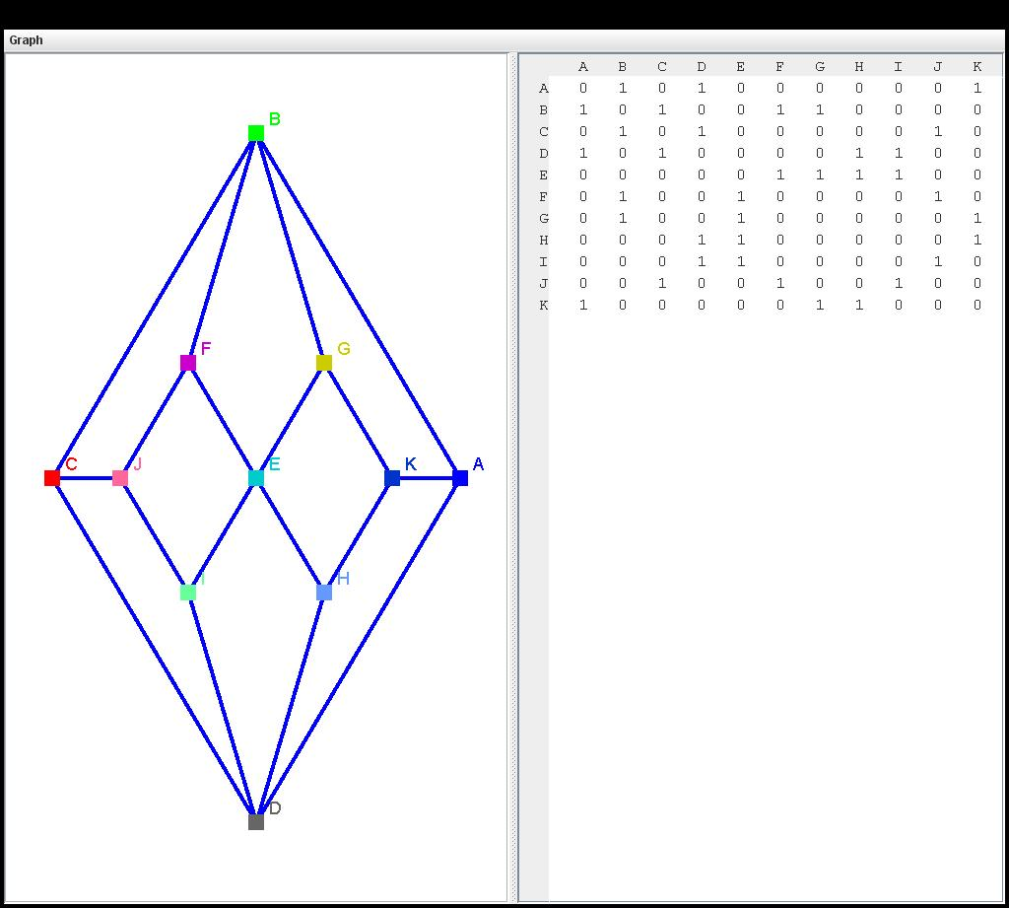
Adjacency Matrix Example

Slide 6
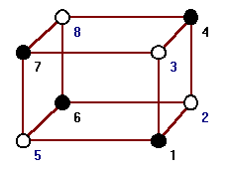
Vertex Coloring
To obtain the proper coloring of a graph you must color each vertex so that it is a different color from all adjacent vertices.
The least number of colors possible to color a graph is called its chromatic number.
We use the notation X(G) for the chromatic number of graph G.
Unplugged activity: http://www.csunplugged.org/graph-colouring
A properly colored graph with a chromatic number of 2.

Slide 7
Applications of Vertex Coloring
Graph coloring can be used to solve problems like scheduling.
Ex. Suppose you want to schedule final exams and, being very considerate, you want to avoid having a student do more than one exam a day. We shall call the courses 1,2,3,4,5,6,7 . In the table below a star in entry i,j means that course i and j have at least one student in common so you can't have them on the same day. What is the least number of days you need to schedule all the exams? Show how you would schedule the exams.
. | 1 | 2 | 3 | 4 | 5 | 6 | 7
1 | . | * | * | * | - | * | *
2 | * | . | * | - | - | - | *
3 | * | * | . | * | - | - | -
4 | * | - | * | . | * | * | -
5 | - | - | - | * | . | * | -
6 | * | - | - | * | * | . | *
7 | * | * | - | - | - | * | .

Slide 8
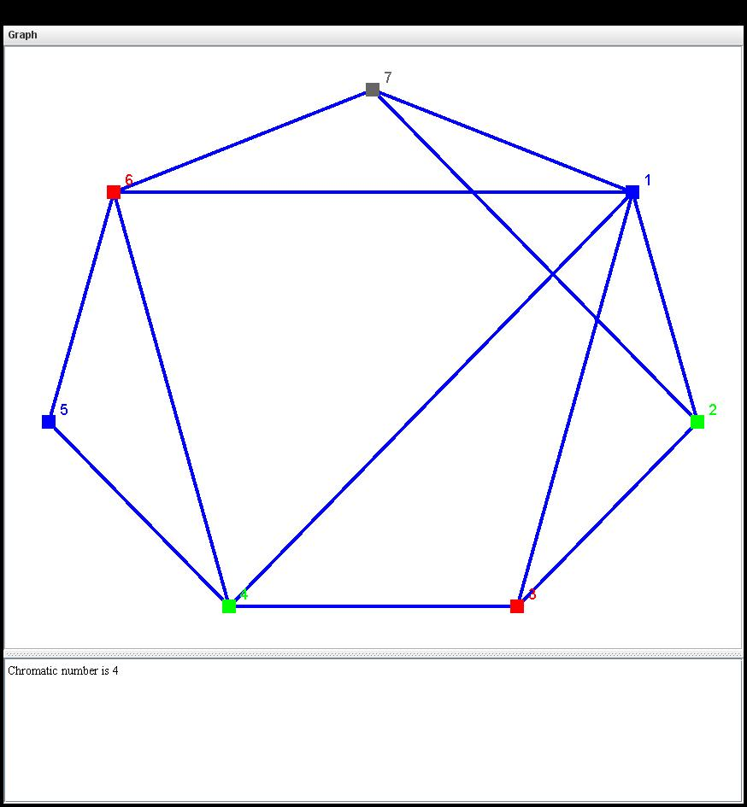
Applications of Vertex Coloring
To solve the problem mentioned previously you could use that table as an adjacency matrix to construct a graph like the one shown here
This graph can be colored with a minimum of 4 colors

Slide 9
Paths and Circuits Definitions
Let G be a graph, and v and w be vertices in G.
A walk from v to w is a finite series of adjacent vertices and edges of G.
A path from v to w is a walk from v to w that does not contain a repeated edge.
A simple path from v to w is a path that does not contain a repeated vertex.
A closed walk is a walk that starts and ends at the same vertex.
A circuit is a closed walk that does not contain a repeated edge.
A simple circuit is a circuit that does not have any other repeated vertex except for the first and last.

Slide 10
Paths and Circuits Definitions Continued
 | Repeated Edge? | Repeated Vertex? | Starts and ends at same point?
Walk | Allowed | Allowed | Allowed
Path | No | Allowed | Allowed
Simple Path | No | No | No
Closed Walk | Allowed | Allowed | Yes
Circuit | No | Allowed | Yes
Simple Circuit | No | First and Last Only | Yes

Slide 11
Euler Circuits and Paths
An Euler Circuit for graph G is a circuit that contains every vertex and every edge of G.
If a graph has an Euler circuit, then every vertex of that graph has an even degree.
If any vertex of a graph has an odd degree then that graph does not have an Euler circuit.
If every vertex of a nonempty graph has an even degree and if the graph is connected then the graph has an Euler circuit.
An Euler Path from v to w for graph G is a path from v to w that passes through every vertex at least once, and traverses every edge exactly once.
There is an Euler path from v to w if, and only if, v and w have both even or odd degrees, and all other vertices of G have an even degree.

Slide 12
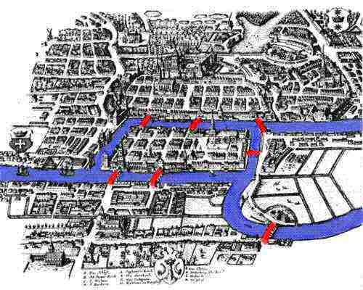
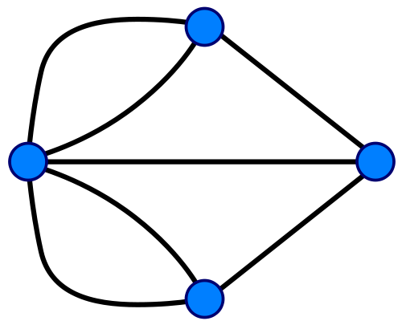
Application of an Euler Path
The most famous Euler Circuit was that of the 7 bridges of Königsberg. This was when Euler created the field of graph theory.
This problem is described as follows:
You must find a walk through the city that crossed each bridge once and only once. The islands could not be reached by any route other than bridges, and each bridge must be crossed completely every time.
Euler simplified the problem into this graphical representation. This graph makes it clear that all 4 vertices have odd degrees. This makes it impossible for an Euler path to be created.

Slide 13
Hamiltonian Circuits
A Hamiltonian circuit for graph G is a simple circuit that includes every vertex of G.
Note that edges can be omitted, and often are in the optimal solution.
If graph G has a nontrivial Hamiltonian circuit, then G has a subgraph H with the following properties:
  H contains every vertex of G.
  H is connected.
  H has the same number of edges and vertices.
  Every vertex of H has degree 2.
Therefore, if graph G does not have a subgraph H with those properties, then graph G does not have a Hamiltonian circuit.

Slide 14
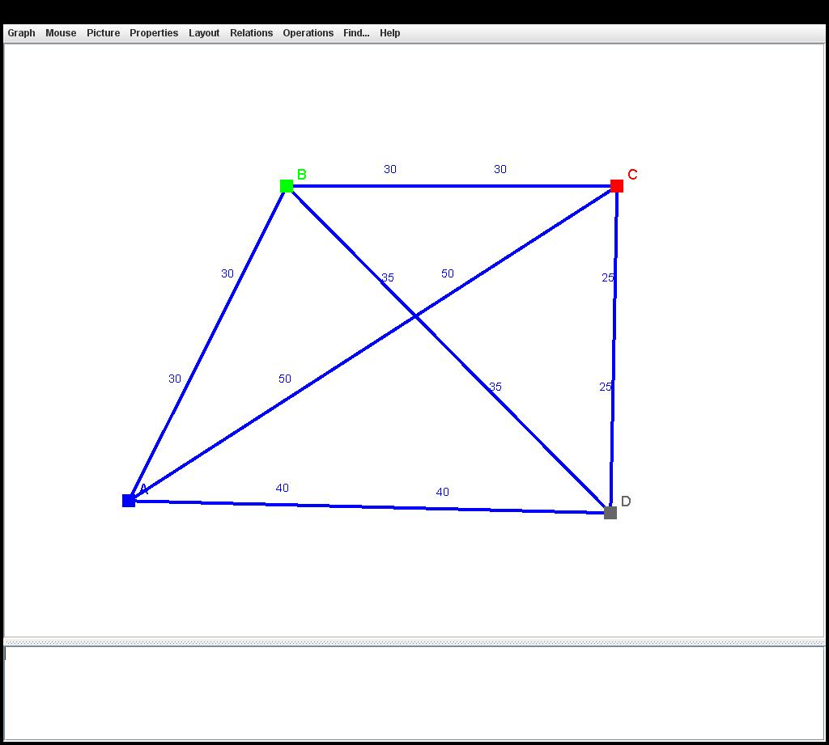
Application of Hamiltonian Circuits: The Traveling Salesman Problem
In the Traveling Salesman Problem you must visit each city exactly once, starting and ending in city A. Which route can you take to minimize the total distance traveled?
This problem can be solved by writing all of the possible Hamiltonian Circuits:
Route | Total Distance
A B C D A | 30 + 30 + 25 + 40 = 125
A B D C A | 30 + 35 + 25 + 50 = 140
A C B D A | 50 + 30 + 35 + 40 = 155
A C D B A | 140
A D B C A | 155
A D C B A | 125
Thus either route A B C D A or route A D C B A gives a minimum total distance of 125.

Slide 15
NP-Complete Problems
The general traveling salesman problem involves finding a Hamiltonian circuit to minimize the total distance traveled for a graph with n vertices in which each edge is marked with a distance.
One way to solve it is the method used above; that of listing out all possible circuits.
This becomes impossible with larger graphs, though:
  For a complete graph with 30 vertices, there would be 29! = 8.84 x 10³⁰ different circuits.
  Even if a circuit could be found and computed in 1 nanosecond, it would still take 2.8 x 10¹⁴ years to finish the computation.
This problem is an example of an NP-complete problem – a set of problems that take a very long time to solve, but have answers that can be verified quickly.
However, there are efficient algorithms that find “pretty good” solutions in a reasonable amount of time.

Slide 16
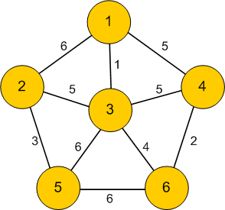
Finding the Shortest Path
Edges on graphs can be given weights representing the cost to travel from one vertex to another.
There are a number of algorithms to find the shortest path on a weighted graph, the most notable of which is Dijkstra’s algorithm.

Slide 17
Dijkstra’s Algorithm
The goal of this algorithm is to find the shortest path between two vertices on a graph.
Once the distance from the start point to a vertex has been calculated, that vertex is considered marked.
For the current node it will consider all adjacent unmarked nodes and determine their distance from the initial node.
If it is less than the previously recorded distance, overwrite it.
Once all adjacent nodes have been considered the current node is marked and the algorithm continues to the next node with the shortest distance.
This process repeats until the terminal vertex has been found.

Slide 18
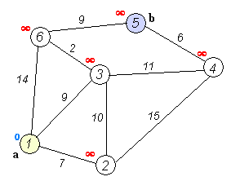
Example of Dijkstra’s Algorithm

Slide 19
Trees
A graph is a tree if, and only if, it has no loops and is connected.
A rooted tree is a tree in which one vertex is distinguished from the others and is called the root.
A Binary tree is a rooted tree in which every parent has at most two children. Each child is either a left child or a right child.

Slide 20
Binary Trees
Binary trees are used to represent algebraic expressions in computers:
((a – b) * c) + (d/e):
+
*
/
–
c
d
e
a
b

Slide 21
Spanning Trees
A spanning tree of graph G is a subgraph of G that contains every vertex of G and is a tree.
A minimum spanning tree is a spanning tree for which the sum of the weights of all the edges is as small as possible.
Unplugged Activity: http://www.csunplugged.org/minimal-spanning-trees

