Slide 1
Modular Arithmetic
Peter Lam
Discrete Math CS
Notes:
Outline
Perform Modular Arithmetic Operations
Demonstrate Understanding of the Relationship of Modular Arithmetic of Two Numbers Being Congruent Modulo n
Solve Practical Problems or Develop Algorithms using Modular Arithmetic or Congruence relations such as creating error detection codes, calculating greatest common factor and solving simple coin-change problems

Slide 2
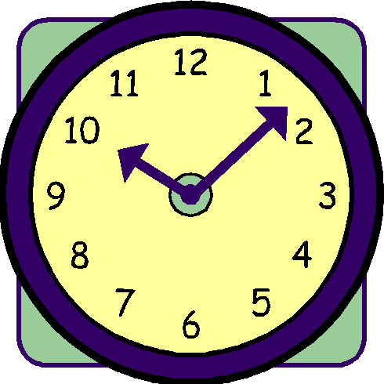
Introduction to Modular Arithmetic
Sometimes Referred to Clock Arithmetic
Remainder is Used as Part of Value
  i.e Clocks
    24 Hours in a Day However, Time is Divided to Two Twelve Hour Periods
    22 Hours is 12 + 10 or Ten O'clock

Slide 3
Intro. To Modular Arithmetic (Cont.)
Modular represents what to divide a number by and that remainder is the result
Any integer will work for Modular n
Is used to simplify equations

Slide 4
Congruence Relation
Equivalence Relation or Algebraic Structure that is Compatible with the Structure
If a-b is divisible by n or remainder is same when divided by n
  Example: 37 ≣ 57

Slide 5
Example Explanation
57-37 = 20 or multiple of 10
37/10 = modulo 7
57/10 = modulo 7
Remainders are the Same

Slide 6
Modular Arithmetic w/Mod 2
Let 0 represent even numbers
Let 1 represent odd numbers
After Some Minor Calculations We Obtain
  0 × 0 ≡ 0 mod 2, Multiplication of Two Even Numbers Result in Even Numbers
  0 × 1 ≡ 0 mod 2, Multiplication of Odd and Even Numbers Result in Even Numbers
  1 × 1 ≡ 1 mod 2, Multiplication of Two Odd Numbers Result in Odd Numbers

Slide 7
Mod 2 Solving Equations
Example
  2a – 3 = 12
  0 * a – 1 = 0 mod 2
  1 = 0 mod 2
  According to the Calculations Aforementioned (1 = 0 ≠ 1 × 1 ≡ 1 mod 2)
    1 ≢ 0 Therefore There is No Integer Solution for 2a – 3 = 12

Slide 8
Properties of Congruence
Reflexivity: a ≡ a mod m.
Symmetry: If a ≡ b mod m, then b ≡ a mod m.
Transitivity: If a ≡ b mod m and b ≡ c mod m, then a ≡ c mod m.

Slide 9
Practical Applications
Finding Greatest Common Divisor
Number Theory
Simplifying Extensive Calculations
Cryptography
  Directly Underpins Public Key Systems
  Provides Finite Fields which Underlie Elliptic Curves
    Used in Symmetric Key Algorithms – AES, IDEA, RC4

Slide 10
Greatest Common Divisor
Commonly denoted as GCD
To find GCD
  Identify minimum power for each prime
  If prime for number a is , and prime for number b is ,
  Then

Slide 11
Example
Find the GCD of 5500 and 450
Prime Factorization of Both 5500 and 450
  5500 = 2², 3⁰, 5³, 11¹
  450 = 2¹, 3², 5², 11⁰
Determine The minimum number between the Two

Slide 12
Example (Cont.)
2² > 2¹ Therefore 2¹ is used
3⁰ < 3² Therefore 3⁰ is used
5³ > 5² Therefore 5² is used
11¹ > 11⁰ Therefore 11⁰ is used
The equation for GCD then becomes
  2¹ * 3⁰ * 5² * 11⁰ = 50
  GCD of 5500 and 450 is 50

Slide 13
Powers and Roots
a^{b} (mod n)
If b is a large integer, there are shortcuts
Fermat’s Theorem

Slide 14
Fermat’s Theorem
If a^{b} (mod n) = 1
  If p is prime and greatest common divisor (a,p) = 1, then, Z_{p}
  a^{(p-1)} = 1
Example 10¹⁴=1 in Z₁₃
Z is a set that represents ALL whole numbers, positive, negative and zero

Slide 15
Cryptography
Modular Arithmetic is a Common Technique for Security and Cryptography
Two types of Cryptography
  Symmetric Cryptography
  Asymmetric Cryptography
Refer to Cryptography Powerpoint for Review

Slide 16
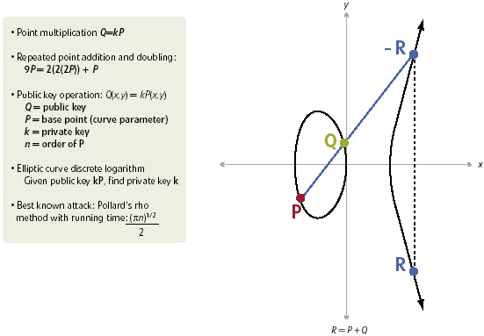
Elliptic Curve Cryptography
Use Elliptic Curve for Asymmetry Cryptography
Point Multiplication
  = kP, k is integer and P is Point on Elliptic Curve
  K is defined as elliptic curve over finite field
  Finite Field is consisted of Modular Arithmetic
  More Advanced – 2
  Finite Fields (Binary
  Fields)

Slide 17
Finite Field in Elliptic Curve Crytography
Finite Field is a set of numbers and rules for doing arithmetic with numbers in that set
Based off Modular Arithmetic
Can be added, subtracted, multiplied and divided
Members of finite field with multiplication operation is called Multiplicative Group of Finite Field

Slide 18
In General
Modular Arithmetic is Used
  To simplify simultaneous equations
  Simplify extensive calculations
  Cryptography and finite fields
There are Many More Applications with Modular Arithmetic

Slide 19
Sources
http://www.cut-the-knot.org/blue/examples.shtml
http://mathworld.wolfram.com/Congruence.html
http://www.math.rutgers.edu/~erowland/modulararithmetic.html
http://www.deviceforge.com/articles/AT4234154468.html
http://www.securityarena.com/cissp-domain-summary/63-cbk-cryptography.html?start=3

