Slide 1
Game Theory
Peter Lam
Discrete Math CS

Slide 2
Outline
Use game theory to solve strictly determining games
Non strictly games
Create models for games
Find optimal mixed strategies such as expected values of or pay off values

Slide 3
Basic Principles
Decision Makers (Players)
Information States at Decision Time
Collection of Possible Moves
Procedure to Determine All Possible Moves
Possible Outcomes Utility or Payoff

Slide 4
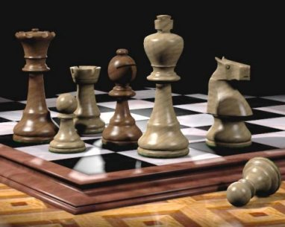
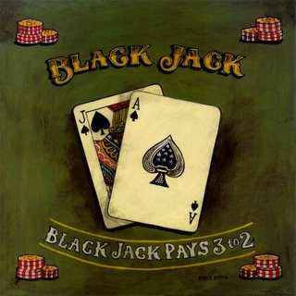
Decision Makers (Players)
Two Ways Players Make Moves
  Chance
  Choice
These affect either
  State of Perfect Information
  State of Imperfect Information
Rules Limit and Determine
Moves and Outcome

Slide 5
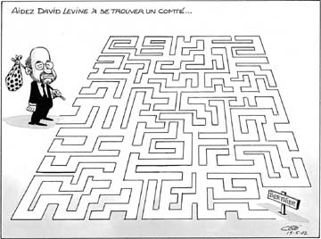
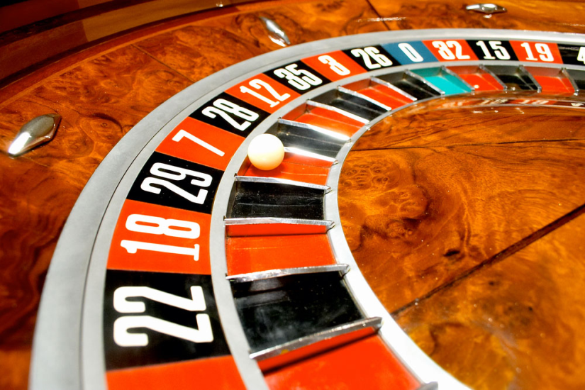
Information States/Possible Moves
State of Perfect Information
State of Imperfect Information
  When Moves are Known to All Players
  Players Use Pure Strategy
    All Moves are Thought Out
When Moves are Made by Chance
Players Use Mixed Strategy
  Moves Based off of Probability Distribution

Slide 6


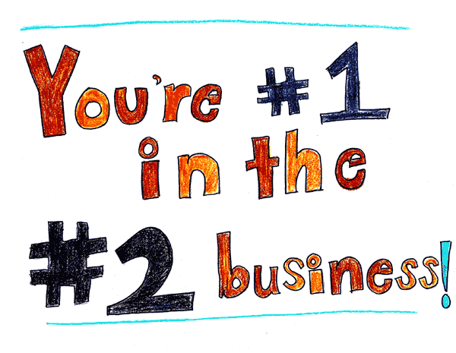
Payoff
State of the Game at its Conclusion
Examples:
  Win/Loss
  Material: Money
  Ranking

Slide 7
Determining Maximum Payoff
Create a Matrix
  List Players Outcomes vs. Others
  i.e. Two Players each with six sided die
  Players roll and loser pays the winner the difference in numbers

Slide 8
Strictly Determined Game
Two Player Zero-Sum Game Consisting
  Nash Equilibrium
  Both Players Using Pure Strategies
  Maximin payoff = Minimax Payoff
Value of Game is Determined by Value of Equilibrium Outcome

Slide 9
Non Strictly Determined Game
Two Player Zero-Sum Game Consisting
  Both Players Use Mixed Strategies
  Maximin payoff < Minimax Payoff
    Not Ideal but Both Players Have Opportunity in Changing their Strategy
Payoff Value Continuously Changes

Slide 10
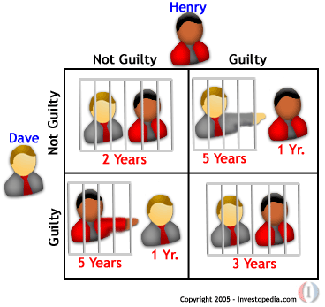
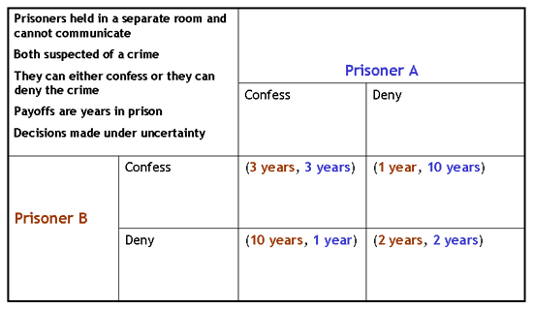
Example:
Prisoner’s Dilemma

Slide 11
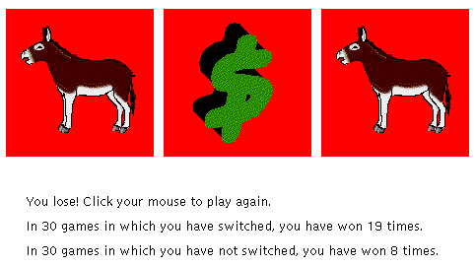
Example:
Let’s Make a Deal
http://www.stat.sc.edu/~west/javahtml/LetsMakeaDeal.html

Slide 12
In General
Game Theory based on Choices of Others
Probability of Outcome Based on Decisions and Rules
Factors That Ultimately Determine Outcome
  Rules
  Player Choices/Decision

Slide 13
Sources
http://econ2.econ.iastate.edu/classes/econ308/tesfatsion/gamedef.308.pdf
http://library.thinkquest.org/26408/math/prisoner.shtml
http://mathchaostheory.suite101.com/article.cfm/what_is_game_theory
http://userpages.umbc.edu/~nmiller/POLI388/MIXED.Q&A.htm

